Slide 1


SAP BTP CPI Training
www.anubhavtrainings.com

Slide 2

DISCLAIMER
The training content and delivery of this presentation is confidential, and cannot be recorded, or copied and distributed to any third party, without the written consent of Anubhav Trainings
www.anubhavtrainings.com

Slide 3


Introduction
www.anubhavtrainings.com

Slide 4
Agenda
POSTMAN to CPI Integration
Multicast
Join and Gather
Converter

Slide 5
Postman CPI Integration
Postman
CPI

Slide 6
POSTMAN CPI integration
Things required
End point URL
CPI User id and password

Slide 7
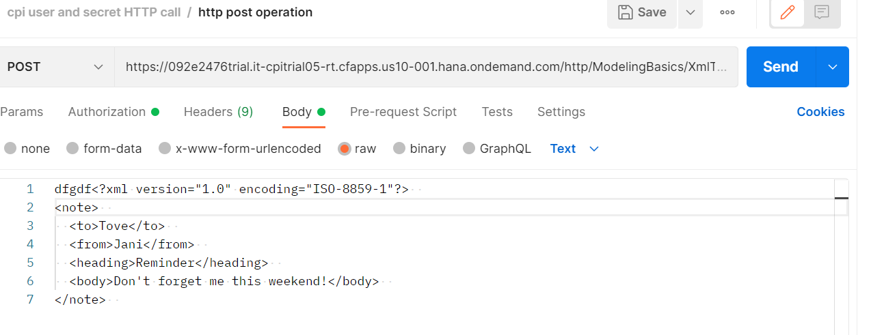
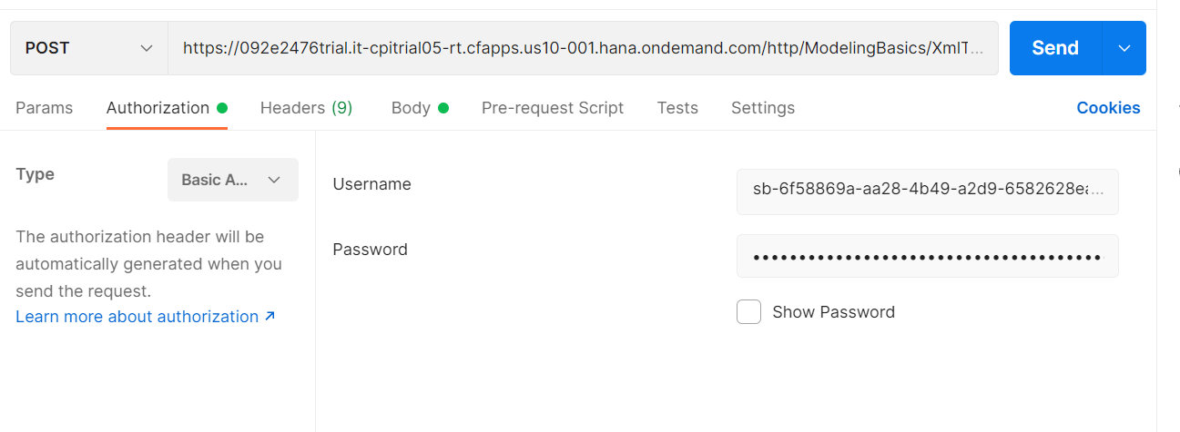
POSTMAN CPI INtegration

Slide 8
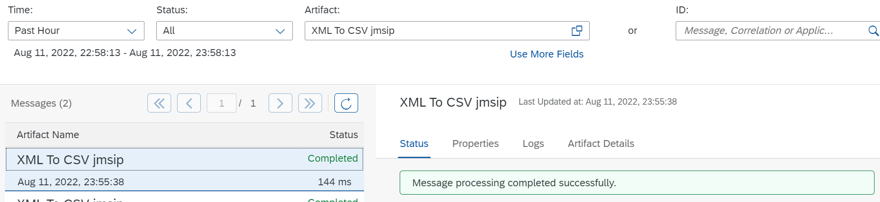
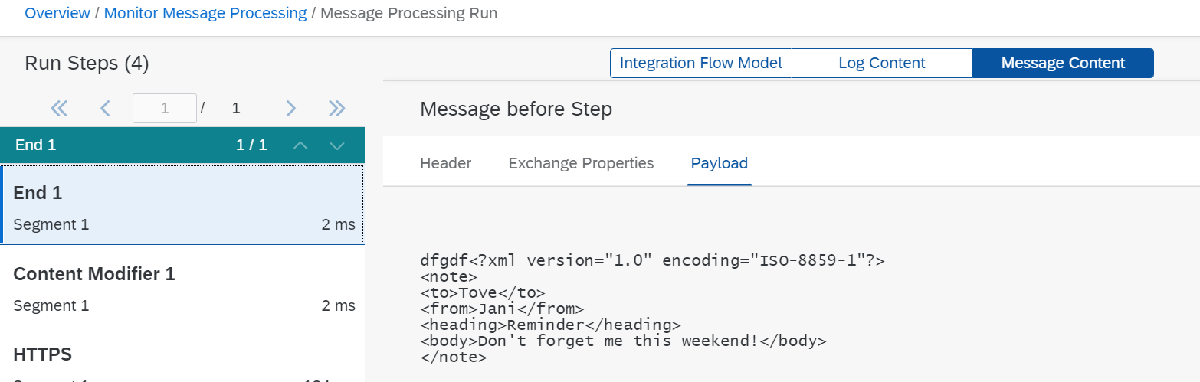
POSTMAN CPI INtegration

Slide 9
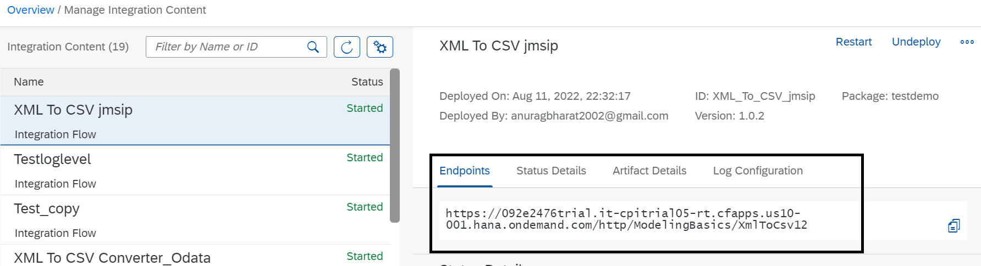
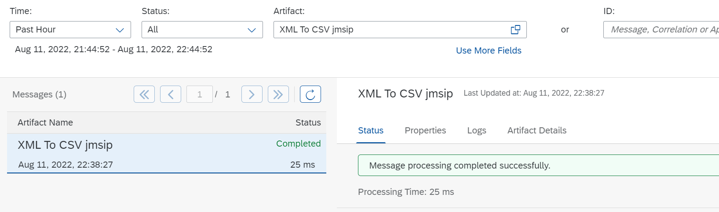
POSTMAN CPI Integration

Slide 10
Multicast
Define Multicast
Context
You can use the Multicast step to send copies of the same message to multiple routes. You can send copies to all routes at once using Parallel Multicast or in an order of your choice using Sequential Multicast. This allows you to perform multiple operations on the same message in a single integration process. Without Multicast, you needed multiple integration processes to perform this task.

Slide 11
Procedure
Procedure
In the palette, choose  (Message Routing), then Multicast.
Choose Parallel Multicast or Sequential Multicast based on your requirement and place the step inside the integration process. Define the message paths based on the scenario.
Based on the order in which you define the message path, the system assigns names to each message route branch as Branch 1, Branch 2, and so on.
If you want to specify a name for this step, enter the value in Name field.
If you are using Parallel Multicast, no further configuration is required for the multicast step.
If you are using Sequential Multicast, you can change the order in which the message should be sent to the Sequential Multicast branches:
Choose Routing Sequence.
Select the branch which you want to move up or down in the order.
Use Move Up and Move Down buttons to change the order.
The branch name is dependent on the order in which you have defined the message path. If you change the order, the branch name will not change.
Save or deploy the configuration.

Slide 12
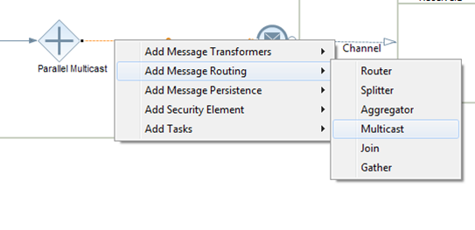
Multicast
The Multicast is represented as a decision icon, or more accurately called as the parallel gateway in BPMN lingo. You can insert the flowstep as shown below:
There are two variants of the Multicast:
Parallel Gateway: All branches of the gateway are executed in parallel.
Sequence Gateway: Branches are executed in the order specified in the Properties tab.

Slide 13
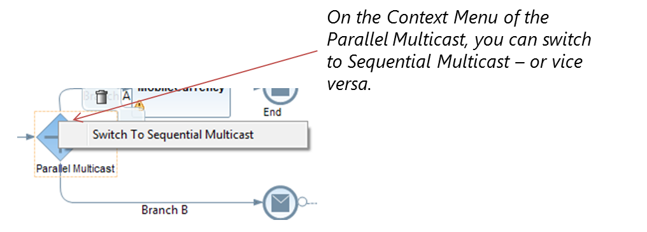
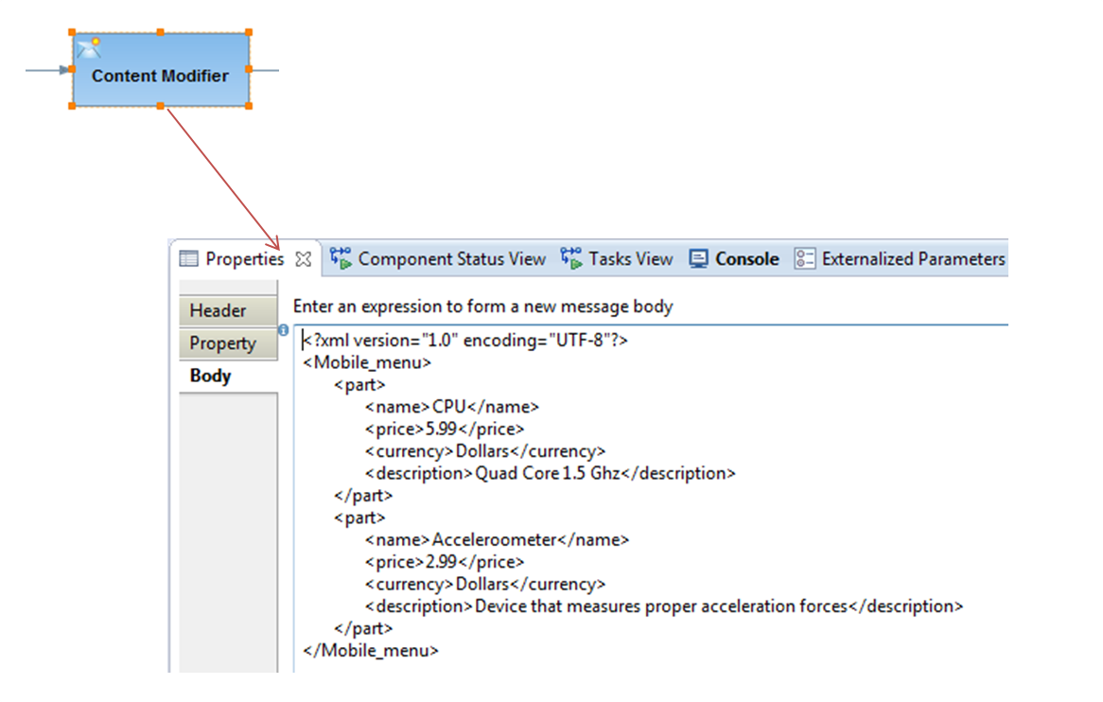
Multicast
You can change between the two variants using the context menu of the multicast flow-step (for right-handers, it appears on right-click of the mouse).
An example Integration Flow
To understand the multicast pattern better, I shall take the example an Integration Flow and insert a Content Modifier step with a sample XML Payload in its body (shown below). In addition, I shall use a simple mapping step that converts the price and currency from Dollars to Euros.

Slide 14
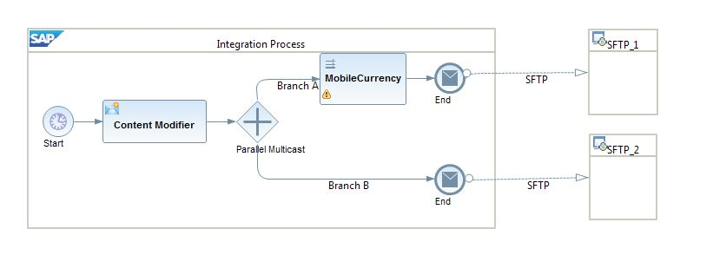
Multicast
What ways can I use the Multicast pattern?
In Integration projects so far, we have seen its usage in the following two ways:
Use case 1: Send the message to multiple receivers. A simplified integration flow is shown below.

Slide 15
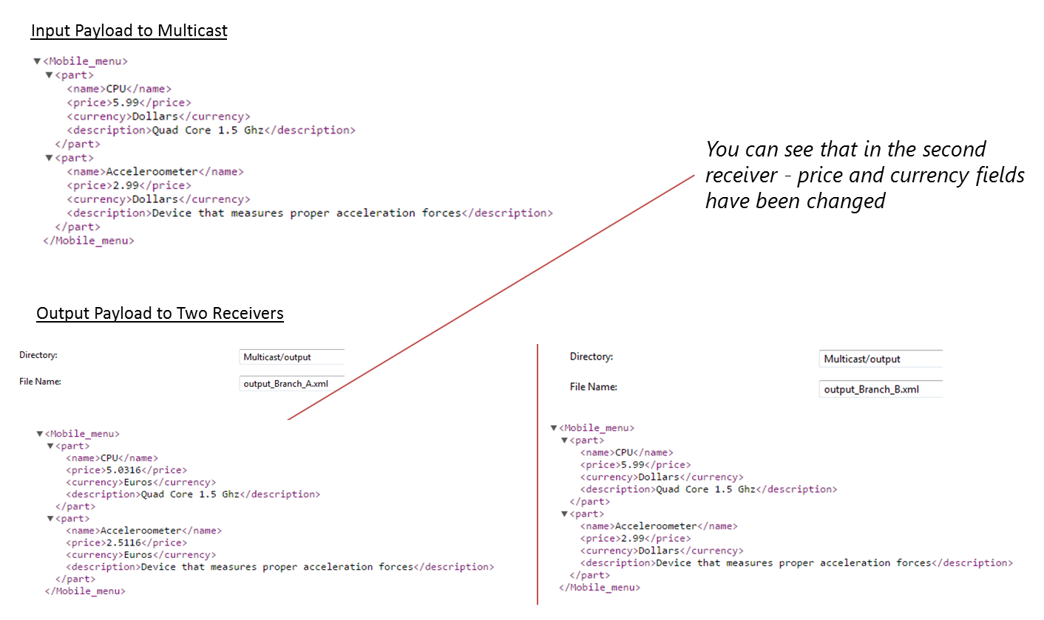
Multicast
The input and output are demonstrated below. The input comes from the Content Modifier step. The first branch modifies the payload based on the mapping rules and the second one receive

Slide 16
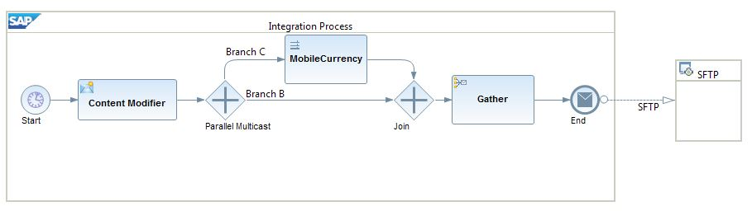
Use case 2: Multiple branches of the integration flow requires the same message contents
There are cases when you require the same message in different branches of the integration flow. This is a pattern also observed in the SuccessFactors scenario integration with 3rd party systems. In this case, you have to use the Join and Gather step. This shall collect all messages from different branches into one message.Example below:

Slide 17
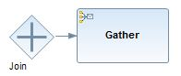
Note: You have to use the Join + Gather step together. A Gather step alone shall not work.
Gather flowstep has quite a few options:

Slide 18
XML Messages
The Gather step enables you to merge messages from more than one route in an integration process. You define conditions based on the type of messages that you are gathering using the Gather step. You can choose to gather:
XML messages of different format
XML messages of the same format
Plain text messages
Based on this, you choose the strategy to combine the two messages:
XML messages of the same format, you can combine or specify the XPath to the node at which the messages have to be combined.
XML messages of different formats, you can only combine the messages
Plain text messages, you can only specify concatenation as the combine strategy

Slide 19
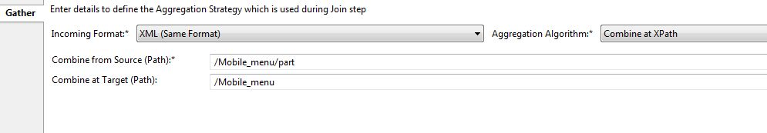
XML Messages
I take the example of XML messages of the same format. For the same payload that I described above, this is the option that I have chosen:

Slide 20
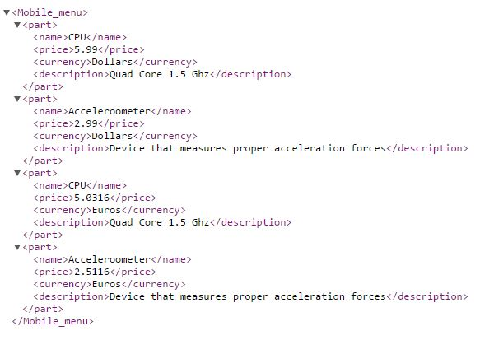
So, here I want to combine all the “<part>”nodes and group it under the main “Mobile_menu” node.
Understanding the aggregation strategy can get a little tricky. I would recommend playing around it with different values to get a hand on it.

Slide 21
Error
What happens in case of Error?
The quality of service applied by default is “Stop on Exception”. In the Message Monitoring, it always shows as a Failed message. Few combinations exist:
If you have a Join+Gather step and one of the incoming branches (parallel or sequential) fails, then the processing is stopped.
When the multicast is connected to multiple receivers, then the successful branches shall receive the message correctly. However, the overall message in the monitoring shall still be shown as Failed.
In a sequential multicast, if a branch fails to execute a message – then the processing is stopped with an exception thrown.

Slide 22
Join and Gather
Define Gather and Join
The Gather step merges messages from different routes (into a single message) with the option to define certain strategies how to combine the initial messages
. The Join step is used in combination with the Gather step. It brings together the messages from different routes, but it does not affect the content of the messages.
Context
The Gather step allows you to define conditions based on the type of messages that are merged. You can choose to gather:
XML messages of different format
XML messages of the same format
Plain text messages
Any format

Slide 23
Join and Gather
The Join element enables you to bring together messages from different routes before combining them into a single message. You use this step in combination with the Gather element. Join only brings together messages from different routes without affecting the content of messages.

Slide 24
Join and Gather
Remember
If you want to combine messages that are transmitted to more than one route by a Multicast step, you need to place Join step before the Gather step.
If you want to combine messages that are split using a Splitter step, you use only the Gather step

Slide 25
XML Messages
Based on your requirements, you choose the strategy to combine the two messages:When combining XML messages of the same format, you have the following options:
Don't specify any condition (multimapping format).
Specify the XPath to the node at which the messages have to be combined.
For XML messages of different formats, you can only combine the messages.
For plain text messages, you can only specify concatenation as the combination strategy.
For all three incoming formats, you can also choose the strategy Zip that allows you to merge the input into a single archive (.zip) file. In that case, you need to specify a file name pattern

Slide 26
Procedure
Procedure
To model a Gather step, in the palette, choose  (Message Routing), then Gather.
Place the Gather element in the integration process and define the message path.
On the General tab, you can change the name of the Gather element.
On the Aggregation Strategy tab, define the attributes of the element based on the descriptions in the following table.

Slide 27
Field | Description
Incoming Format | Specify format of incoming message. XML (Same Format) If messages from different routes are of the same format XML (Different Format) If messages from different routes are of the different format Plain Text If messages from different routes are of the plain text format Any If you want to combine any incoming messages independent of their format
Aggregation Algorithm | There are the following options: Combine (can only be selected if for Incoming Format you have selected XML (Same Format) or XML (Different Format)) Combine the incoming messages without any conditions. The messages are combined in Multimapping format.Note In case you are using the mapping step to map the output of this strategy, you can have the source XSD in the LHS and specify the Occurrence as 0..Unbounded. Combine at XPath (can only be selected if for Incoming Format you have selected XML (Same Format)) Combine the incoming messages at the specified XPath. Concatenate (can only be selected if for Incoming Format you have selected Plain Text) Concatenate the information from the different sources one after another Zip Aggregates files to an archive (.zip) file. Caution With this option, empty messages will not be included in the generated archive files. Tar Aggregates files to an archive (.tar) file. Caution With this option, empty messages will not be included in the generated archive files. Remember Any information that is in the header or property of a previous step is not aggregated by a Gather step.
Combine from source (XPath) (Enabled only if for Aggregation Algorithm the option Combine at XPath is selected) | XPath of the node that you are using as reference in the source message to retrieve the information.
Combine at target (XPath) (Enabled only if for Aggregation Algorithm the option Combine at XPath is selected) | XPath of node that acts as the root for combined message.
File Name (Enabled only if for Aggregation Algorithm the option Zip or Tar is selected) | Specify a simple expression to define unique file names within the archive. If not specified, header CamelFileName is evaluated. In case the header is not available at runtime, a unique file name will be generated

Slide 28
Define Router
Usage of Operators in Non-XML Conditions
Operator | Example
= | ${header.SenderId} = '1'
!= | ${header.SenderId} != '1'
> | ${header.SenderId} > '1'
>= | ${header.SenderId} >= '1'
< | ${header.SenderId} < '1'
<= | ${header.SenderId} <= '1'
and | ${header.SenderId}= '1' and ${header.ReceiverId} = '2'
or | ${header.SenderId}= '1' or ${header.ReceiverId}= '2'
contains | ${header.SenderId} contains '1'
not contains | ${header.SenderId} not contains '1'
in | ${header.SenderId} in '1,2'
not in | ${header.SenderId} not in '1,2'
regex | ${header.SenderId} regex '1.*'
not regex | ${header.SenderId} not regex '1.*'
Context
You perform this task when you have to specify conditions based on which the messages are routed to a receiver or an interface during runtime. If the message contains XML payload, you form expressions using the XPath-supported operators. If the message contains non-XML payload, you form expressions using the operators shown in the table below:

Slide 29
You can define a condition based on property or exception that may occur.
If the condition ${property.SenderId} = '1' is true, then Router routes the message to a particular sender whose Sender ID is 1.
If the condition ${exception.message}contains 'java.lang.Exception' is true, then Router routes the message to a particular receiver, otherwise it routes to another receiver.

Slide 30
Procedure
Procedure
In the palette, choose  (Message Routing), then Router.
Place the Router element in the integration process and define the message path.
Select either Router or the routing branch (Route) splitting from the router.
If you select Router, then execute the following steps:
On the General tab, you can change the name of the Router element.
On the Processing tab, select Throw Exception to respond to an error occurence.You can also use Error End Event to raise an exception.
In the Routing Condition table, select the default route.If you select Throw Exception, the default route must terminate with Terminate Message.
If you select Route, then execute the following steps.
On the General tab, you can change the name of the route.
On the Processing tab, from the Expression Type dropdown, select the type of expression used to formulate the routing condition.
Select XML to form an expression using XPath or select Non-XML to form an expression using message header, property, or exception.
In the Condition field, formulate a valid XML or non-XML condition that routes the message to its associated receiver.

Slide 31
If you want to set the selected route as the default, so that its associated receiver handles the error situation if no receiver is found, select the Default Route option.

Slide 32
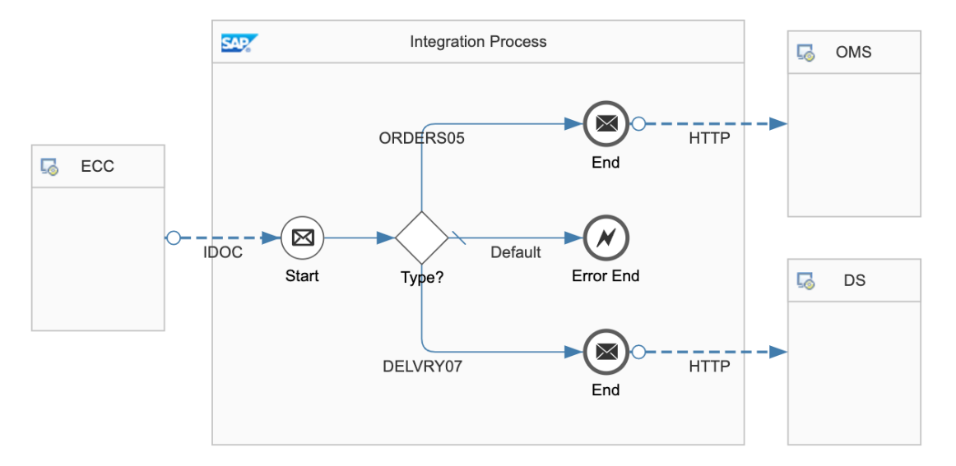

Slide 33
Adapters
Connects SAP Cloud Integration to Sender or Receiver
HTTPS:
Establishes an HTTPS connection between SAP Cloud Integration and a sender system.

Slide 34
HTTP ADAPTER
Parameters of the HTTPS Sender Adapter
Parameter | Description
Address | Enter the URL of the HTTP system to connect to.
Authorization | Specifies the authorization option for the sender.
CSRF Protected | This option prevents Cross-Site Request Forgery (CSRF), which is a malicious online attack. Such attacks exposes user content without their authorization.
CamelHttpUrl
Refers to the complete URL called, without query parameters.
For example, CamelHttpUrl=https://test.bsn.neo.ondemand.com/http/hello.

Slide 35
Postman CPI Integration
Postman
CPI

Slide 36
POSTMAN CPI integration
Things required
End point URL
CPI User id and password

Slide 37
POSTMAN CPI INtegration

Slide 38
POSTMAN CPI INtegration

Slide 39
POSTMAN CPI Integration

Slide 40
CSV to XML Converter
Procedure
In the palette, choose , then navigate to Converter CSV to XML Converter.
Place the CSV to XML converter shape in the integration process and define the message path.

Slide 41
CSV to XML Converter
Choose CSV to XML Converter and provide values in fields based on description in table.

Slide 42
CSV to XML Converter
Field | Description
XML Schema | Choose Browse. Select the XML schema you want to use. Optionally, you can also upload the XML schema from your local file system by choosing Upload from File System.
Path to Target Element in XSD | XPath in the XML schema file where you want to place the content from CSV file.
Record Marker in CSV | The record in CSV file that indicates the entry that the converter has to consider as the starting point of the content. Note If you don’t provide a value for this field, the converter considers all the records in the CSV file for conversion.
Field Separator in CSV | Select the character from dropdown list that is used as the field separator in CSV file. Tip If you want to use a field separator that isn’t available in the dropdown list, manually enter the character.
Exclude First Line Header | Select this checkbox if you want to use the header information from the first line of CSV file to map the column to the corresponding xsd attributes.Note If you don't select the checkbox, then the converter maps the attributes of the CSV file to the order of occurrence in the XSD. To use this option, the CSV and XSD must share the same header-attribute names. If the header names don't match or the same header name is used multiple times in the first line of the CSV, it leads to ambiguity that the converter can resolve as it's an unsupported XML specification.
Choose CSV to XML Converter and provide values in fields based on description in table

Slide 44
Schema
<?xml version="1.0" encoding="UTF-8" standalone="yes"?><xs:schema attributeFormDefault="unqualified" elementFormDefault="qualified" xmlns:xs="http://www.w3.org/2001/XMLSchema"> <xs:element name="Products"> <xs:complexType> <xs:sequence> <xs:element minOccurs="1" maxOccurs="unbounded" name="Product"> <xs:complexType> <xs:sequence> <xs:element nillable="false" maxOccurs="1" name="ProductId"> <xs:simpleType> <xs:restriction base="xs:string" xmlns=""> <xs:maxLength value="10"/> </xs:restriction> </xs:simpleType> </xs:element> <xs:element type="xs:string" nillable="true" minOccurs="0" maxOccurs="1" name="Name" xmlns=""/> <xs:element nillable="true" minOccurs="0" maxOccurs="1" name="Category"> <xs:simpleType> <xs:restriction base="xs:string" xmlns=""> <xs:maxLength value="40"/> </xs:restriction> </xs:simpleType> </xs:element> <xs:element nillable="true" minOccurs="0" maxOccurs="1" name="DimensionUnit"> <xs:simpleType> <xs:restriction base="xs:string" xmlns=""> <xs:maxLength value="3"/> </xs:restriction> </xs:simpleType> </xs:element> <xs:element type="xs:decimal" nillable="true" minOccurs="0" maxOccurs="1" name="DimensionDepth" xmlns=""/> <xs:element type="xs:decimal" nillable="true" minOccurs="0" maxOccurs="1" name="DimensionHeight" xmlns=""/> <xs:element type="xs:decimal" nillable="true" minOccurs="0" maxOccurs="1" name="DimensionWidth" xmlns=""/> <xs:element type="xs:decimal" nillable="true" minOccurs="0" maxOccurs="1" name="Weight" xmlns=""/> <xs:element nillable="true" minOccurs="0" maxOccurs="1" name="WeightUnit"> <xs:simpleType> <xs:restriction base="xs:string" xmlns=""> <xs:maxLength value="3"/> </xs:restriction> </xs:simpleType> </xs:element> </xs:sequence> </xs:complexType> </xs:element> </xs:sequence> </xs:complexType> </xs:element></xs:schema>

Slide 45
CSV to XML Converter

Slide 48
XML to CSV Converter
Procedure
In the palette, choose , then Converter XML to CSV Converter.
Place the XML to CSV converter in the integration process and define the message path.

Slide 49
CSV to XML Converter
Field | Description
Path to Source Element in XSD | Path to the source element in the XSD file
Field Separator in CSV | Select the character that you want to use as the field separator in CSV file from dropdown list Tip If you want to use a field separator that is not available in the dropdown list, manually enter the character.
Include Field Name as Headers | Select this checkbox if you want to use the field names as the headers in CSV file
Include Parent Element | Select this checkbox if you want to include the parent element of the XML file in CSV file
Include Attribute Values | Select this checkbox if you want to include attribute values in the CSV file
Choose XML to CSV Converter and provide values in fields based on description in table

Slide 50
Json to XML converter
The JSON to XML converter enables you to transform messages in JSON format to XML format.
Procedure
In the palette, choose , then choose Transformation Converter JSON to XML Converter.
Insert the converter at the desired position in your integration process. The converter appears as a graphical element in your integration process.
The properties tab page for the XML to JSON Converter opens.

Slide 51
Json to XML converter
Tab | Option | Description
General | Name | Enter the name of the converter.
Processing | JSON Prefix (only if the option Use Namespace Mapping is selected) | Enter the mapping of the JSON prefix to the XML namespace. The JSON namespace/prefix must begin with a letter and can contain aA-zZ and 0-9.
 | JSON Prefix Separator | Enter the JSON prefix separator to be used to separate the JSON prefix from the local part. The value used must not be used in the JSON prefix or local name. The following characters are allowed: colon(:), comma(,), dot(.), pipe(|), semicolon(;), and space.
 | Add XML Root Element | Select this option to convert JSON documents with an XML root element
 | Name (only if the option Add XML Root Element is selected) | Enter the name of the XML root element. The name must comply with the NCName rules: The name must begin with a letter or an underscore. The valid characters for the remainder of the name are: Letters Digits Period Hyphen Underscore
 | Namespace Mapping (only if the option Add XML Root Element is selected) | Enter the namespace of the XML root element that you have configured in the integration flow.
Define the parameters for your conversion, see table below

Slide 52
XML to JSON Converter
Procedure
In the palette, choose  Transformation Converter XML to JSON Converter.Your cusor symbol
Insert the converter at the desired position in your integration process.The converter appears as a graphical element in your integration process.
The properties tab page for the XML to JSON-Converter opens

Slide 53
XML to JSON Converter
Option | Description
Name | Enter the name of the converter.
JSON Output Encoding | Enter the JSON output encoding. The default value is from header or property. If you select from header or property, the converter tries to read the encoding from the message header or exchange property CamelCharsetName. If there is no value defined, UTF-8 is used.
XML Namespace (only if the option Namespace Mapping is selected) | If you select from header or property, the converter tries to read the encoding from the message header or exchange property CamelCharsetName. If there is no value defined, UTF-8 is used.
JSON Prefix Separator (only if the option Namespace Mapping is selected) | Enter the JSON prefix separator to be used to separate the JSON prefix from the local part. The value used must not be used in the JSON prefix or local name. The following characters are allowed: colon(:), comma(,), dot(.), pipe(|), semicolon(;), and space.
Suppress JSON Root Element | Choose this option to create the JSON message without the root element tag.
Define the parameters for your conversion, see table below

Slide 54
Message Mapping
Message Mapping is nothing but a set of rules for producing target XML from the source XML.
These rules are nothing but relations between the source XML tags and target XML tags”
For example, consider the record Employee and we need to update the employee identification number. In the sender system, the field name is Employee ID. However, in the receiver system, the same field is called ID.

Slide 55
Source Field | Target Field
Employee | User
Employee ID | ID
Employee Name | Name
Employee Surname | LastName
Date of Birth | DOB

Slide 56
Use
You use message mapping, to define an association between fields of messages with different structuring. This enables the Cloud Integration system to recognize and update the relevant fields in the target systems.

Slide 58
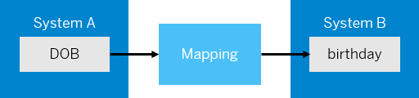
Standard and Custom Mapping Functions
In the same scenario, let us assume that the date of birth in system A is in YYYY-MM-DD format. You want to change the format to DD-MM-YYYY, the format in system B. In this case, you can use a mapping function that transforms the data into the format that you want, which in this case is DD-MM-YYYY.

Slide 59
The mapping editor provides some standard functions like Arithmetic, Boolean, Constants, Conversions, and Date.
If you're unable to achieve the desired transformation using standard functions, you can create a custom function in one of the following ways.Choose  (create script) to create a custom-mapping function by manually entering the script.
Choose  (add script file) to upload a script file that contains the custom-mapping function.

Slide 60
Testing
Testing Message Mapping
The mapping editor provides 2 ways of testing message mapping:Simulate – for testing the entire mapping XML.
Display Queue – for testing a specific node of the XML.

Slide 61

Summarize
LET’S SUMMARISE!

Slide 62

Summarize
End of Day 5

Slide 64


We’re committed to empower you to be
#FutureReady
through powerful training solutions.
We build the workforce of the future.
250+
Corporate Clients
30,000+
Learners Trained
25000+
Learners Placed
FREE WEBINARS
Sign up for free webinars with industry experts every fortnight!
Enroll Now!
Contact us today!
https://anubhavtrainings.com

